Slide 1
Let's talk about tests
Unit tests, component tests, integration tests, E2E tests, contract tests.

Slide 2
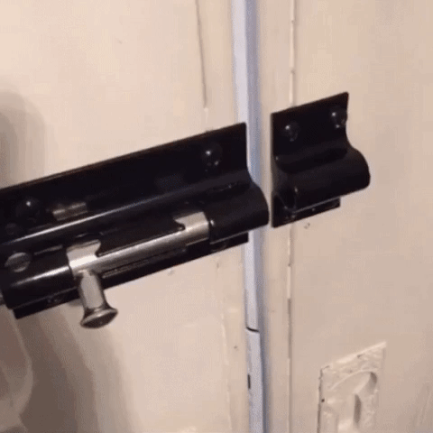
Once upon a time, all unit tests are passing, but...

Slide 3
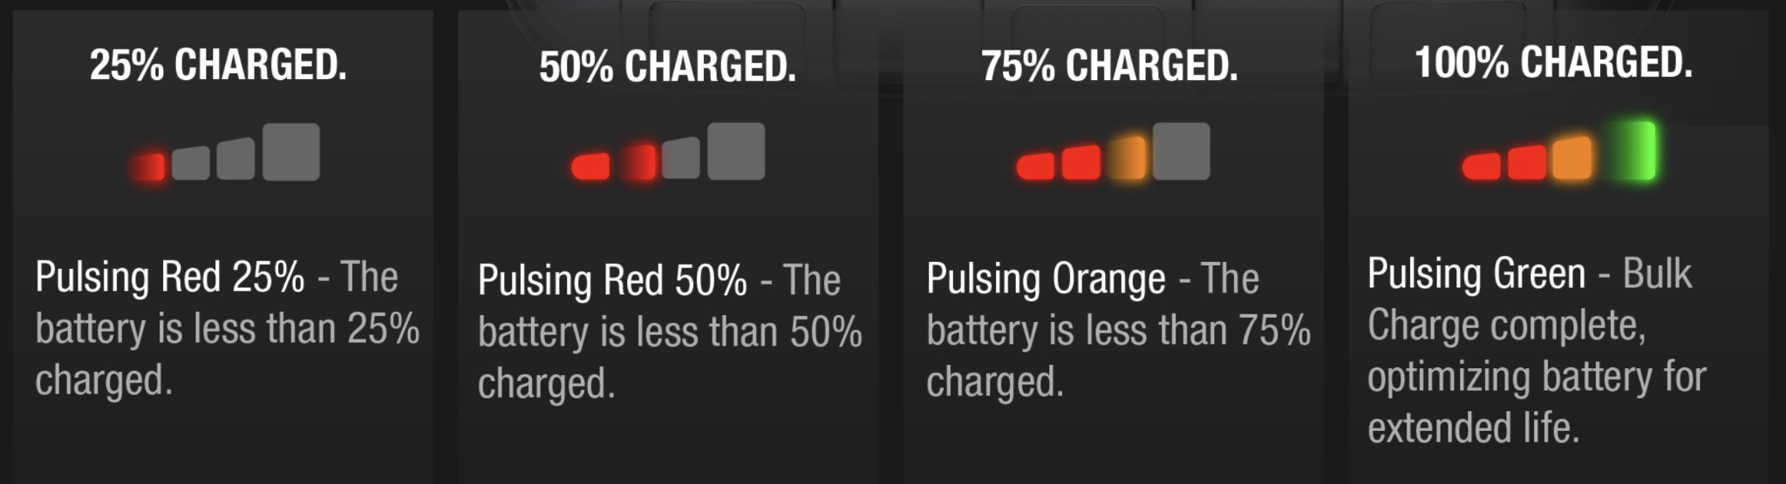
What are tests?
Tests are specifications.
Notes:
People should be able to read the test and tell what does this endpoint/component deliver.

Slide 4
What are tests?
Tests are feedback loops.
New Theory
Implement test
yes
Test passed?
no
Theory confirmed
Notes:
Here is my theory, implement the tests as the theory and run it. If the test passes, the theory is correct. Otherwise, it’s incorrect.
Fast & take less resources: so that it can be kept running while we developing.
Stable: same results every time.
Focus on the element of the behaviour.

Slide 5

What are tests?
Tests increase our confidence of our code.
Notes:
Tests increase our confidence of our code. All developers deserve a good sleep.

Slide 6


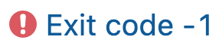
What does it mean by fail?
=
Notes:
Something broken and we need to fix it.

Slide 7

What does it mean by passed?
=
?
Notes:
What do we say for deployment? “Wish me luck!” “Fingers across.”

Slide 8

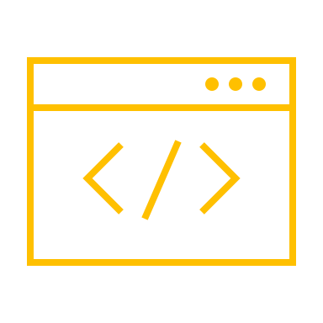

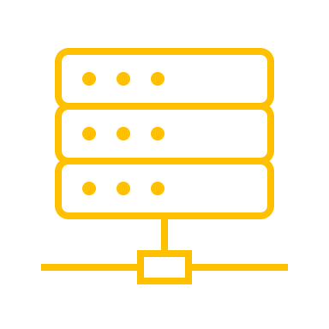
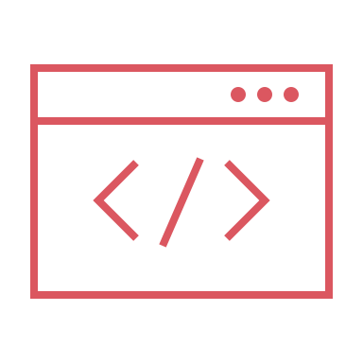

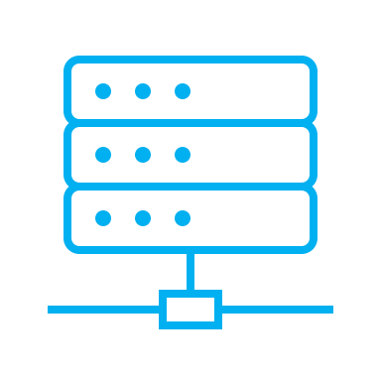

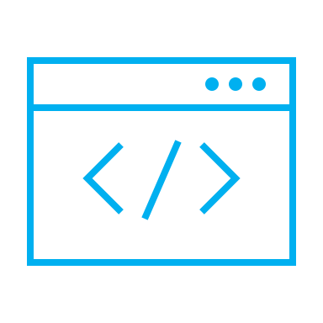

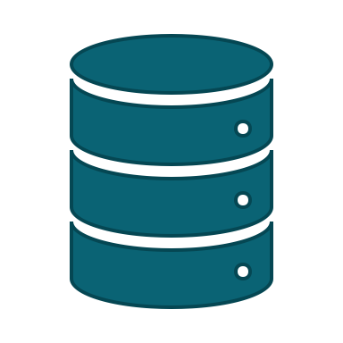
Problems: 1 unit test = 1 lock
Controller
Handler
Listing Service
Services & Helpers
Listing Admin Service
Queue
Agency Service
DynamoDB
SQL
Notes:
How do you want to refractor?

Slide 9
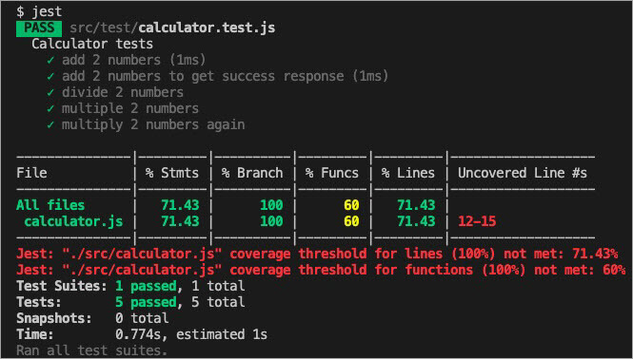
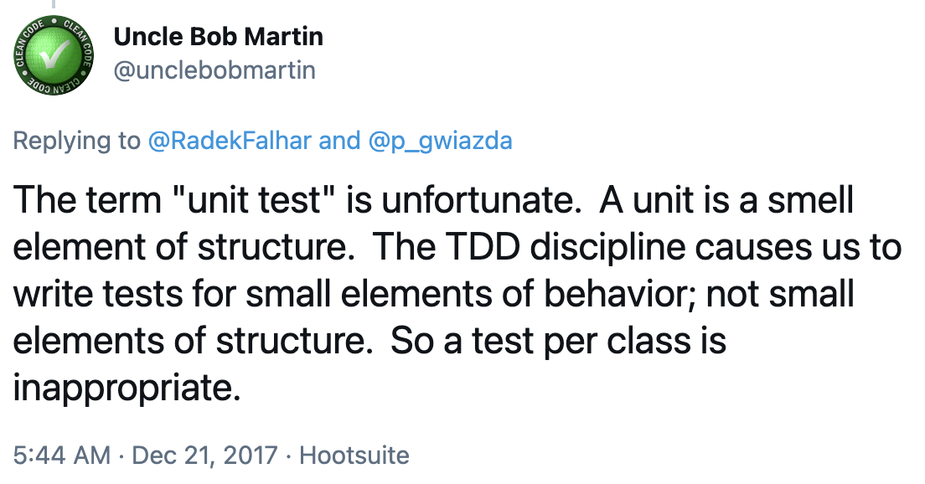
Tests are (not) unit tests
Tests are in a form of unit tests.
The term “Unit test” is unfortunate.

Slide 10
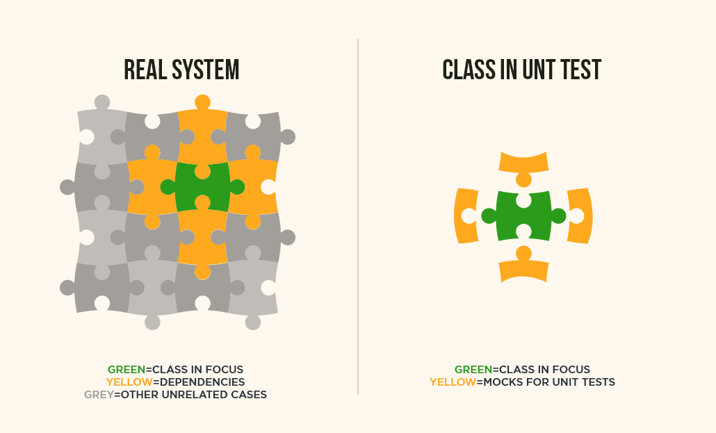
The problem of mock

Slide 11
Test on the interface, not the structure.
interface IDependency {
…
}

Slide 12

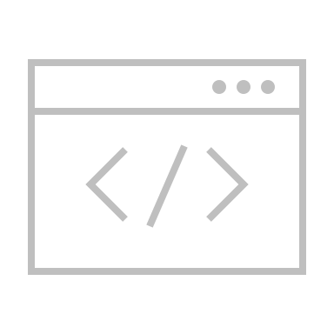

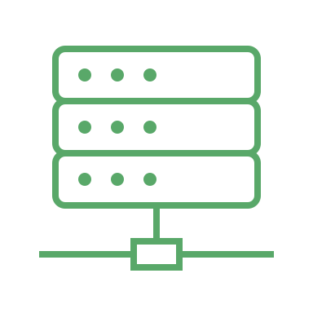

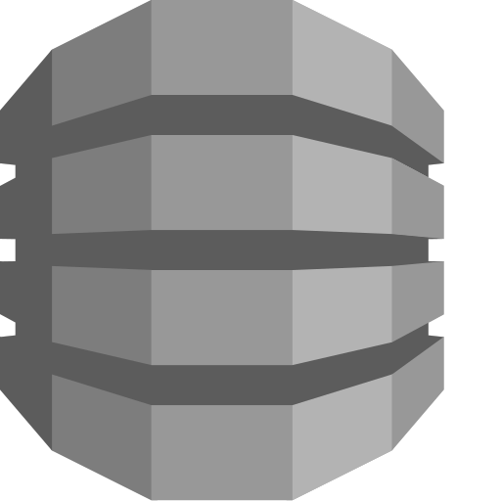
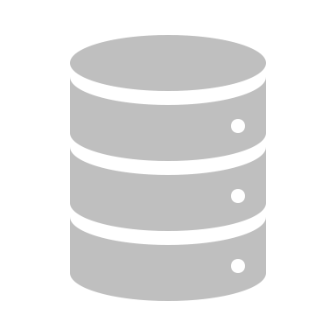
Test on the interface, not the structure.
Endpoints
In-memory web server
Serialization / deserialization
Exception v.s. Http status code
Heavy ➔ Slow
Controller
Validations
Logics
Grow the code
Light ➔ Fast
Mock this
Handler
Listing Service
Mock this
Services & Helpers
Listing Admin Service
Mock this
Mock this
Queue
Agency Service
Mock this
Mock this
DynamoDB
SQL
Notes:
You’re not going to test on auth. Simple responsibility.
Complexity
Stability
Feedback Time

Slide 13


Test on the interface, not the structure.
props
logics
grow the code
React Component
Listing Service
Subcomponent A
Subcomponent B
Subcomponent C
Mock axios/fetch
Listing Admin Service
Services & Helpers
Agency Service
Notes:
Component Test? Integration Test? System Test?

Slide 14
Any question?
Tests are for development.

Slide 15
Contract tests v.s. E2E tests

Slide 16

Problem of current integration tests
Cannot release
Fail
Listing Service
staging/endpoint
Listing Admin Service
Services & Helpers
Agency Service

Slide 17

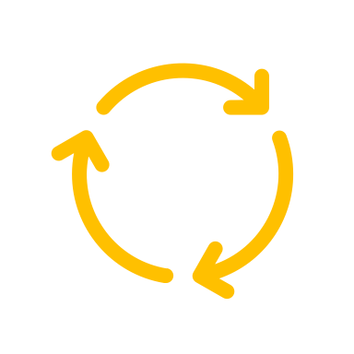
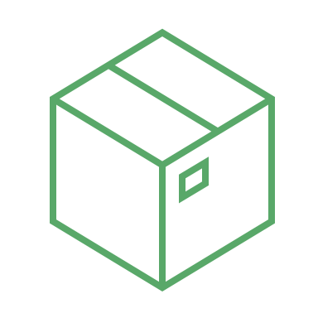
Problem of E2E tests
It takes time to run and maintain.
breaks a lot
Longer feedback cycle.
It takes lots of resources.

Slide 18
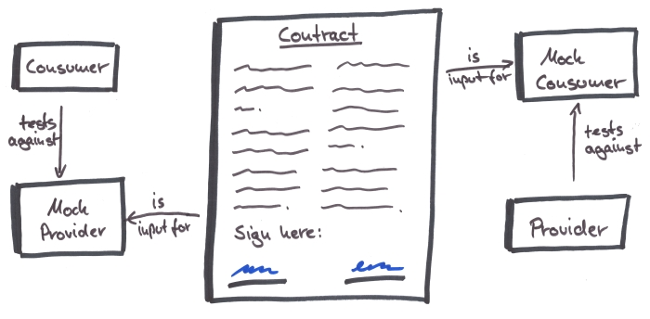
Contract tests

Slide 19
Any question?
Notes:
What can we do now?
Understand the software behavior by tests instead of mouse clicks.
Change/implement the tests before change the code.

Slide 20
References
First-Class Tests
Clean Code - Uncle Bob
7 Reasons to Choose Consumer-Driven Contract Tests Over End-to-End Tests

